Slide 1
First Project - EDA
Data Science using linear regression
NeueFische

Slide 2
The Data – The King House Sale
Data Set as Csv
21 „different“ varibales
21597 observation for „each“ variable
Observation over 390 days
Goal Setting: to predict Price(varibale to be explained) with a high R²
Ols- Regression: y=α+β⋅x+e

Slide 3
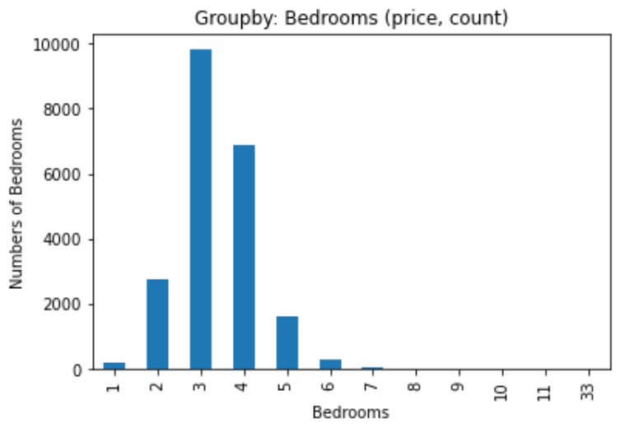
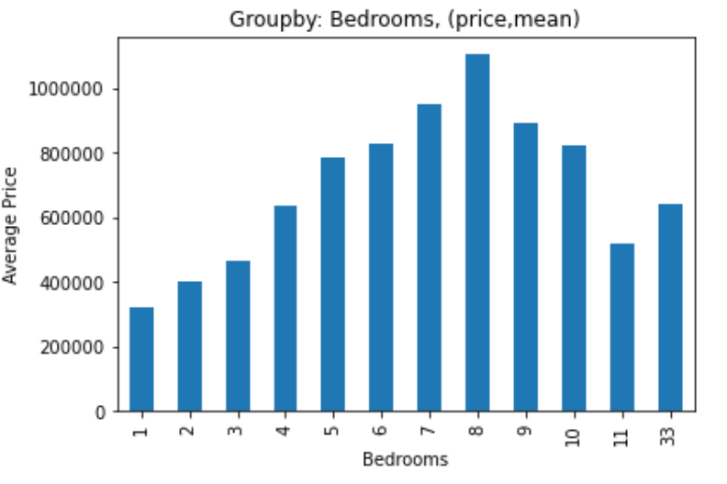
Visualize raw data to search for connections. Part 1
Looks like a normal distribution
Most in demand: 3 bedrooms
Write down: extreme values availabe

Slide 4
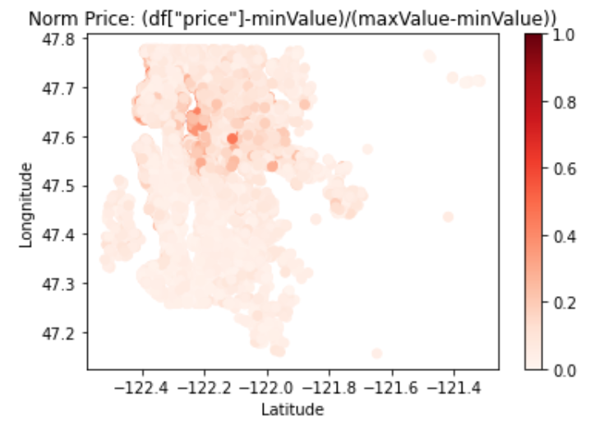
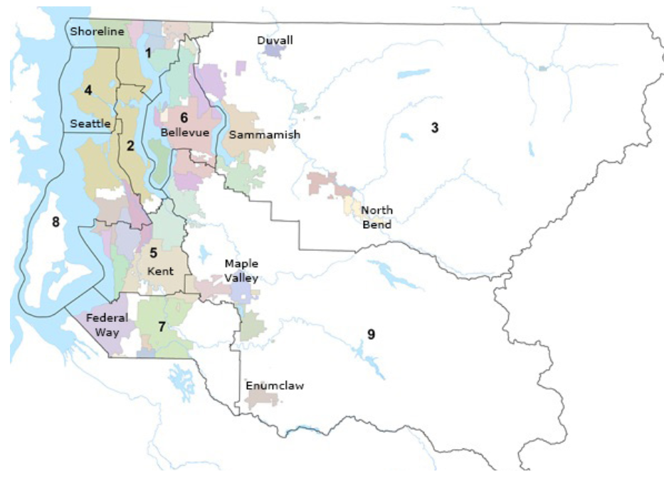
Visualize raw data to search for connections. Part2

Slide 5
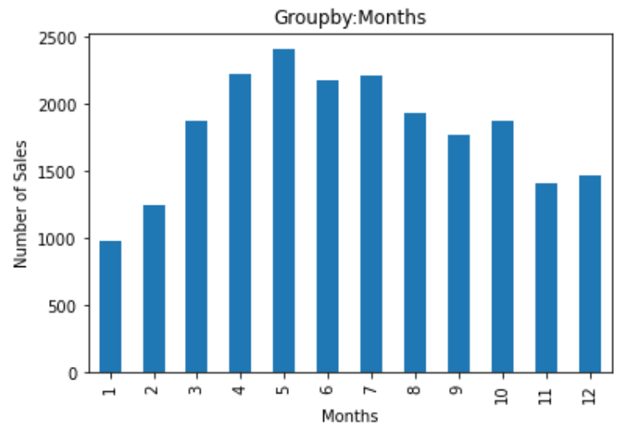
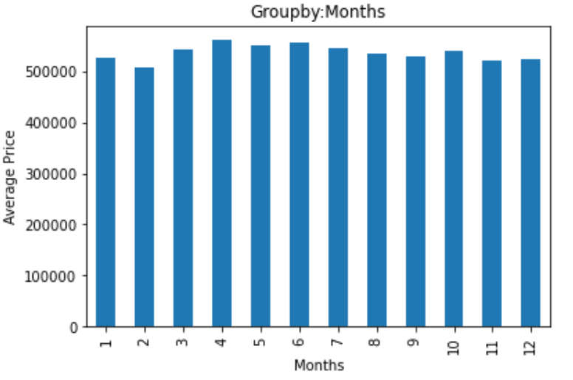
Visualize raw data to search for connections. Part3
-more sales in summer as winter
-most sales in May (attention)
df["price"].min()
#Output: 78000
df["price"].max()
#Output: 770000
- df.groupby('months').describe()['price']['mean'].std()
#Output: 150702,0528…

Slide 6
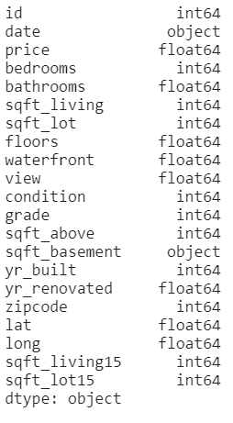
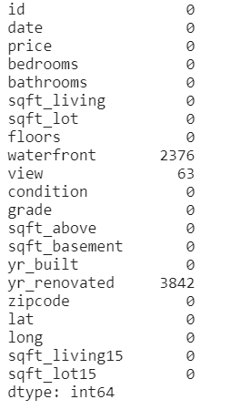
Data Wrangling
df.dtypes
- we need to transform our datatypes from object to integer or float
- df.isnull().sum()
we need to clean our data set from nan‘s and „?“
Remove id, yr_renovated
df.replace("?", np.nan, inplace=True)
Replace 63 values in view with 0 (view.mean=0,007…)
df = df.fillna(0)

Slide 7
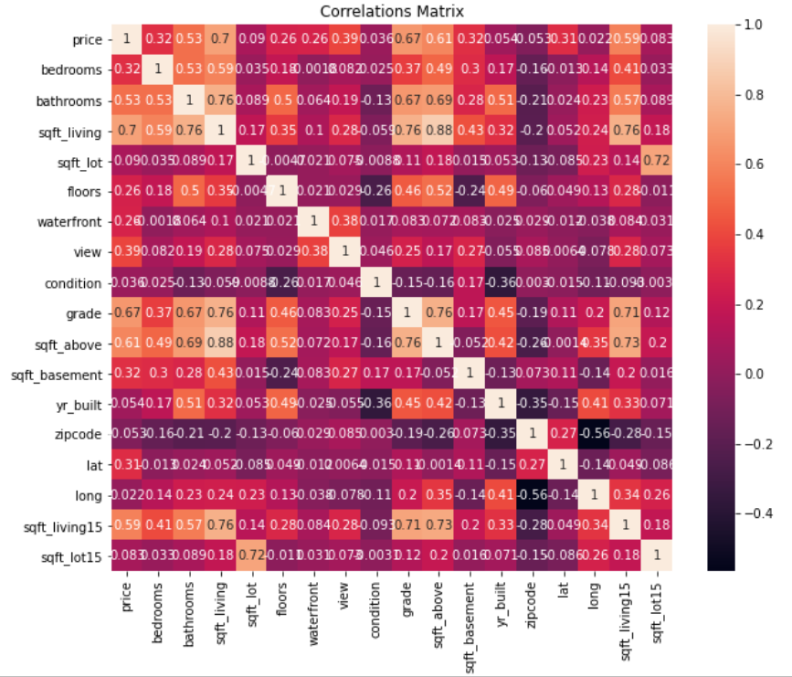
Data Wrangling: Check for Price Correlation
remove: "sqft_lot15", "long",
"zipcode",
"yr_built",
"condition",
"sqft_lot"

Slide 8
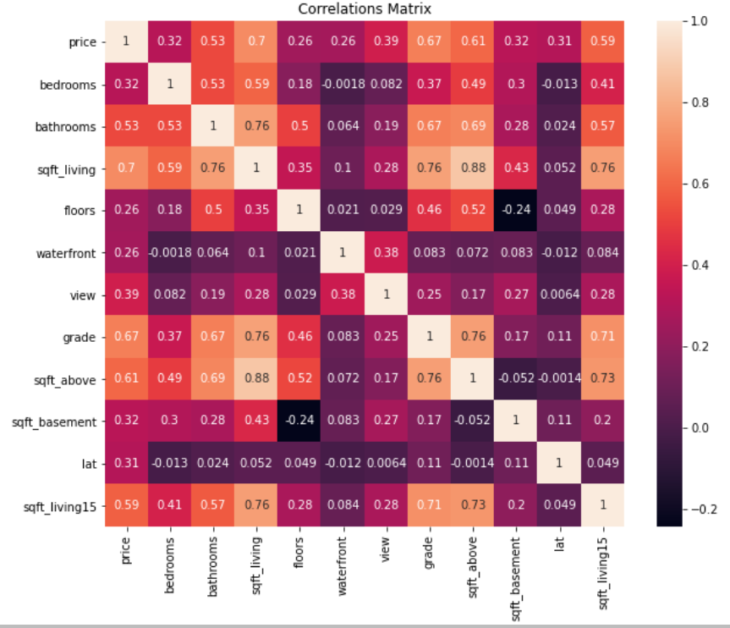
Data Wrangling: Check for explanatory variable Correlation
remove:"sqft_above","sqft_living15"

Slide 9
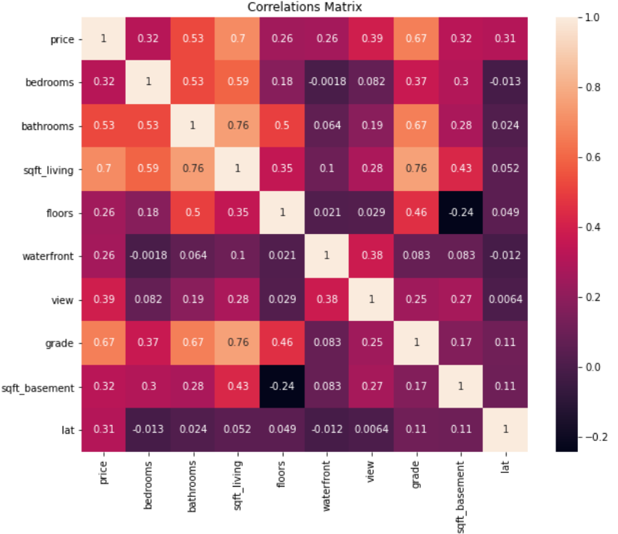
Data Wrangling
Our model ist until now:
Price= bedrooms*x
+bathrooms*x
+sqft_living*x
+floors*x
+waterfront*x
+view*x+grade*x
+sqft_basement*x
+lat*x

Slide 10
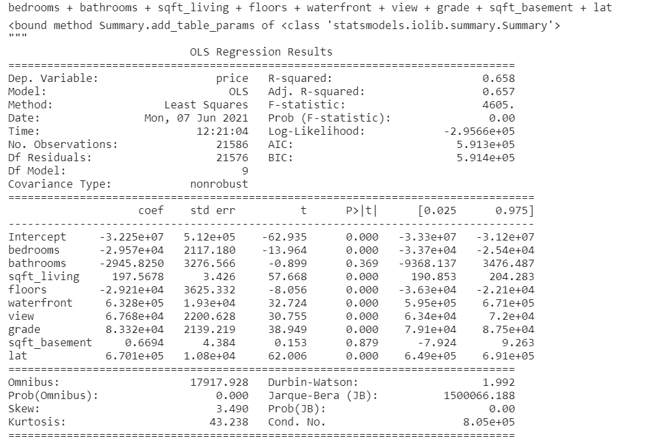
OLS
- Remove : „bathrooms“ and sqft_basement

Slide 11
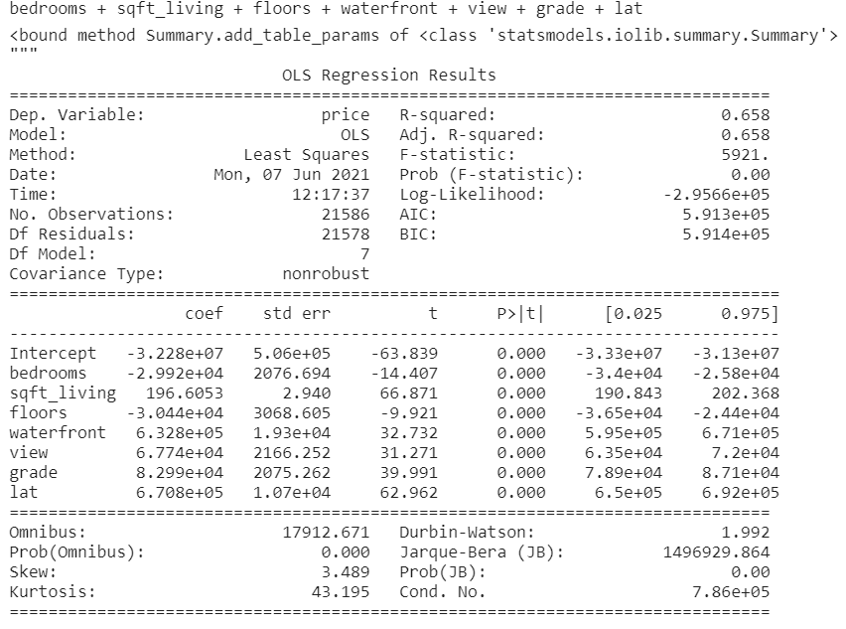
OLS

Slide 12
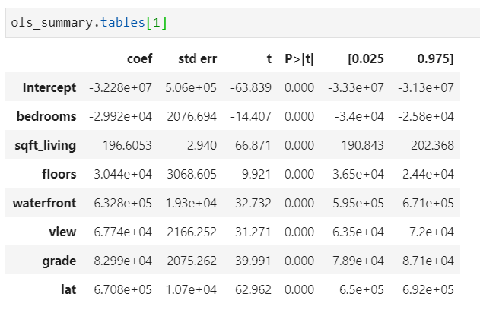
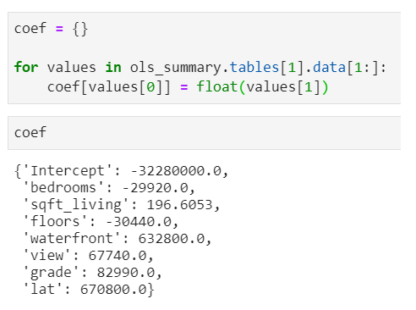
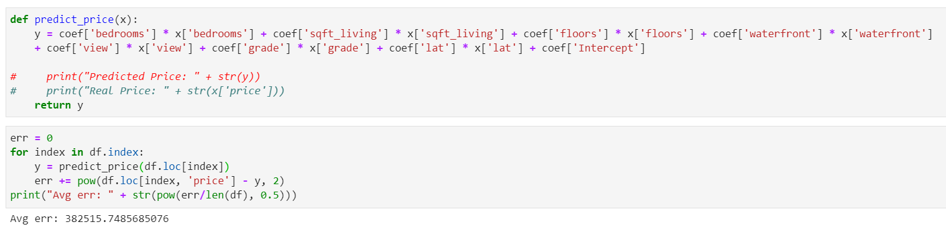
Prediction
1.
2.
3.

Slide 13
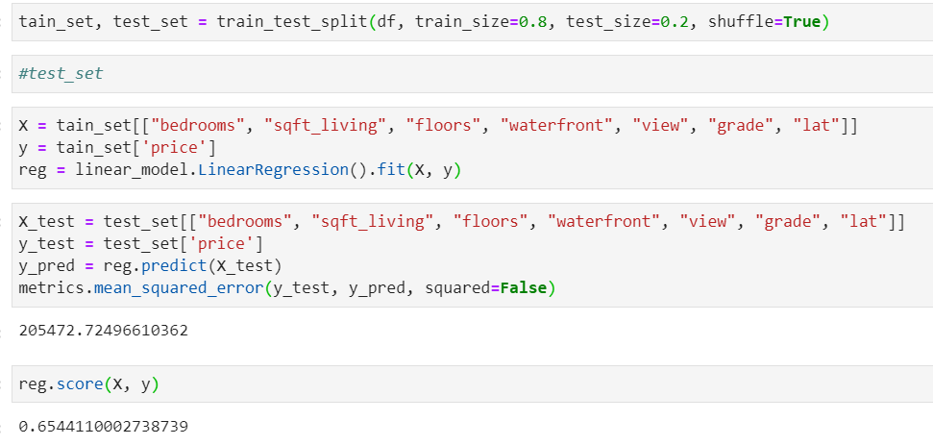
Scikitlearn

Slide 14
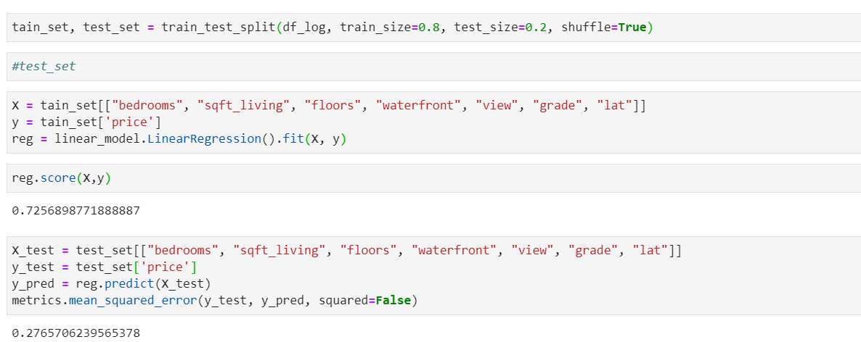
Scikitlearn: Log-Lin-Modell

Slide 15
Vielen Dank für eure Aufmerksamkeit

